Slide 1

Credit Card Fraud Detection
By Carine Munezero Uwase
System and Network Security, Fall 2024

Slide 2
Why this project matter?
In today’s world, cashless transactions are the backbone of our economy. credit card technologies enable quick, contactless payments, making our lives more convenient. However, these same technologies come with significant security risks, such as Eavesdropping Attacks: Where malicious actors intercept sensitive payment data during transmission.
Rapid Growth of Digital Transactions: Increased reliance on digital payments creates opportunities for fraud. Cybercriminals are evolving their tactics and exploiting vulnerabilities in wireless technologies Everyday. In 2022, payment fraud losses reached over $32 billion globally.
Inaccurate Flagging of Fraudulent Transactions: Legitimate transactions are often flagged as fraudulent, frustrating customers and leading to reduced trust in the payment systems. This inefficiency also burdens banks and businesses, as they must dedicate resources to investigating non-fraudulent cases.
Limitations of Traditional Fraud Detection Systems High false-positive rates lead to customer dissatisfaction and inefficiency.
Machine Learning in Network Security helps to analyze vast amounts of transaction data in real-time to detect fraud
Personal Motivation: My strong interest in machine learning paired with ensuring customer trust and confidence in financial systems through secure, modern fraud prevention methods.

Slide 3
Resources Used
Kaggle.com: https://www.kaggle.com/ (The dataset contains transactions made by credit cards in September 2013 by European cardholders.)
Machine Learning Models: Logistic Regression, Shallow Neural Network (by TensorFlow/Keras using, layers for deeper learning), Random Forest Classifier, Linear Support Vector Machine (Linear SVM), Gradient Boosting
Development Environment: Google Colab ( for writing and executing commands and python code
Libraries and Tools: Pandas ( for data preprocessing), NumPy ( for numerical computation) Scikit-learn (for Logistic Regression, Random Forest, and Linear SVM)
TensorFlow/Keras (for Shallow Neural Network)

Slide 4
Steps
Data Preparation: Shuffling and scaling features to ensure fairness and consistency.
Model Training: Trained models on imbalanced data, using 5 algorithms
(Logistic Regression, Linear SVM, Random Forest Classifier, Gradient Boosting
Classifier, Shallow Neural Network).
Model Evaluation: evaluate their performance using metrics like accuracy, precision, recall, F1-score
Data Balancing: Balanced the dataset to improve the model’s prediction quality
Model Selection: Chose the best model based on F1 score.

Slide 5
Essential Terms & Concepts
Trade-off Between Precision and Recall:
Precision: The proportion of correct fraud predictions out of all predicted frauds.
Recall: The proportion of actual frauds detected by the model.
F1 Score: The harmonic mean of precision and recall
Shuffling and Pre-Processing: Essential for ensuring data is randomized, normalized, and scaled to improve model accuracy and reduce bias.
False Negatives (Type II Error):When a fraudulent transaction is missed and incorrectly classified as legitimate
False Positives (Type I Error): When a legitimate transaction is incorrectly flagged as fraudulent, causing unnecessary disruptions for customers
An epoch is one complete pass through the entire training dataset. After each epoch, the model parameters (weights) are updated based on the performance on the training data.
Fitting Data: The process of training the model on data to learn patterns or relationships for prediction
Overfitting: The model is too complex, and it "memorizes" the training data but struggles to generalize to new data.
Underfitting: The model is too simple, and it fails to learn from the training data, resulting in poor performance on both training and new data.

Slide 6
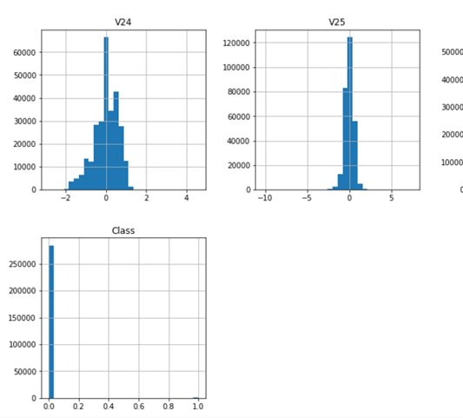
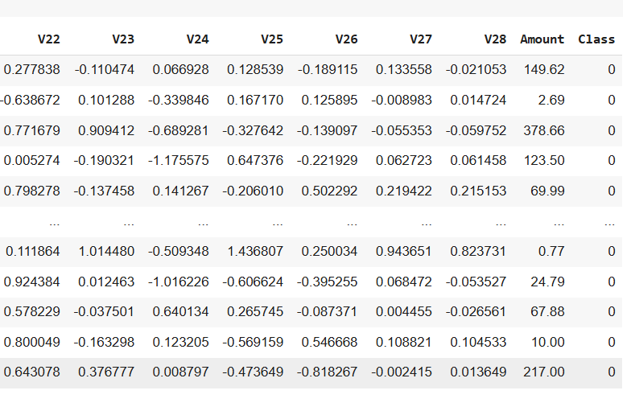
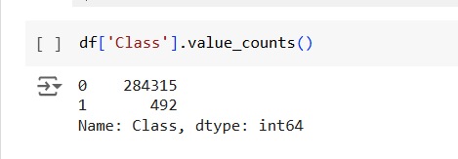
Data Preparation

Slide 7
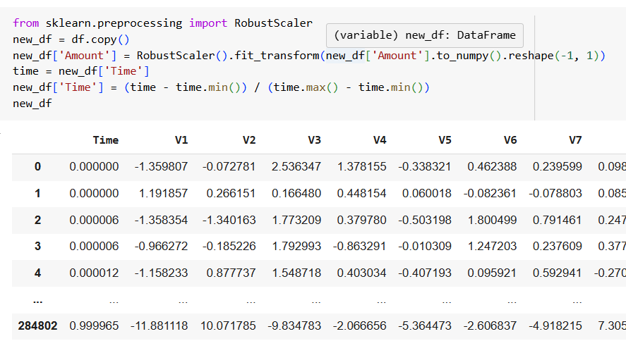
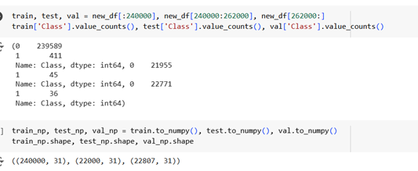
Data Preparation
Feature Scaling: Normalizing data (using RobustScaler) ensures that all features are on a similar scale, improving model performance and convergence.
Train-Test Split: Separating data into training, validation, and test sets ensures unbiased evaluation of the model.

Slide 8
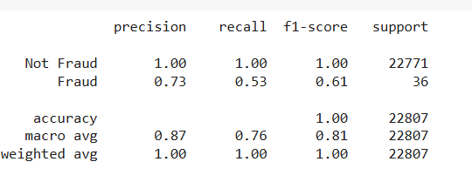
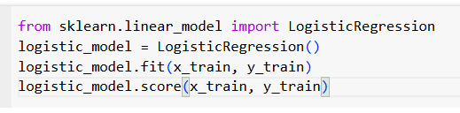
Training the Logistic Regression Model
Logistic Regression is a popular machine learning algorithm used for binary classification problems like fraud detection.
It estimates the probability of a binary response based on one or more predictor variables.
How It works: The model learns from the training data (x_train, y_train) by fitting the logistic function to predict whether a transaction is fraud or not.
Training is done by adjusting model parameters (coefficients) to minimize the error between the predicted and actual values.

Slide 9
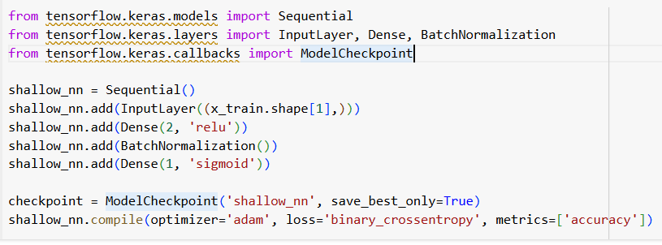
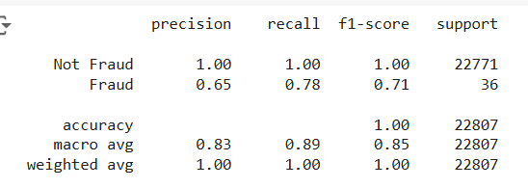
Training Shallow Neural Network built with TensorFlow
A shallow neural network is a type of machine learning model consisting of an input layer, one or more hidden layers, and an output layer.
The Sequential API in Keras allows layers to be stacked in a linear fashion, where each layer passes data to the next.
ReLU (Rectified Linear Unit) is an activation function used in hidden layers to introduce non-linearity, helping the model learn complex patterns. Batch Normalization normalizes the output of each layer to stabilize and speed up training.
The output layer uses a Sigmoid activation function, which provides a probability value for binary classification.
Adam optimizer adjusts the model's weights during training, ModelCheckpoint to save the best model during training.

Slide 10
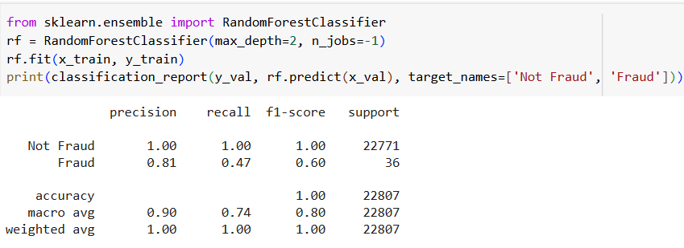
Training Random Forest Classifier
Random Forest is an ensemble learning algorithm that builds multiple decision trees and combines their predictions. It uses a collection of models (trees) to improve accuracy and prevent overfitting.
And then Limits the depth of each decision tree, preventing them from becoming too complex. Ex here: max_depth=2
The model makes predictions by majority voting across the individual trees.

Slide 11
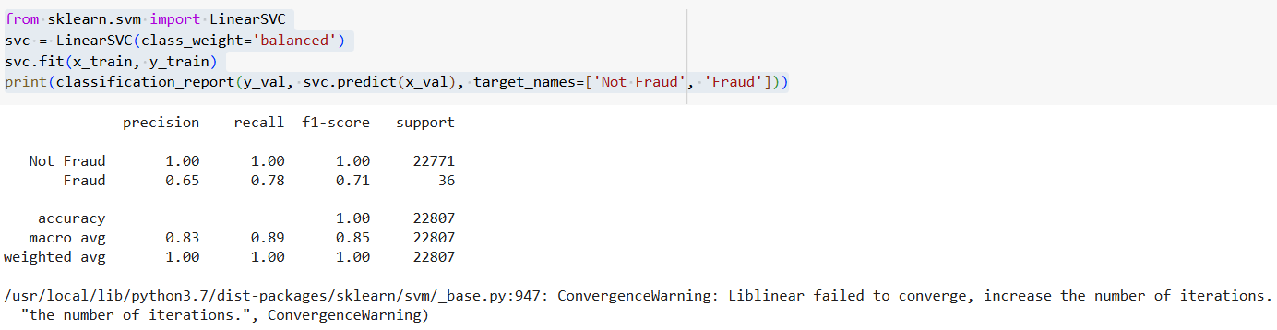
Training Linear Support Vector Classifier (LinearSVC)
The Linear Support Vector Classifier (LinearSVC) is a machine learning model used for classification tasks. It works by finding the best hyperplane that separates the data into different classes. In this case, the model is used to distinguish between "Fraud" and "Not Fraud" transactions.
By setting class_weight='balanced', the model adjusts for any class imbalance by giving more importance to the underrepresented class, which is crucial in fraud detection where fraudulent transactions are often fewer than non-fraudulent ones

Slide 12
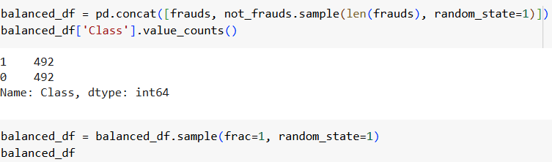
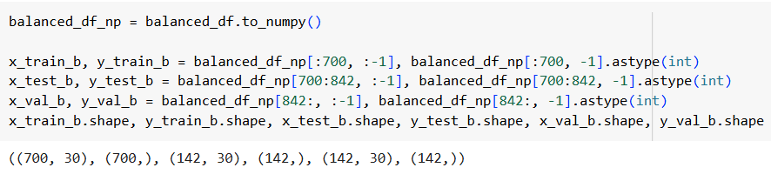
Balancing the Dataset
Objective: Credit card fraud cases are much fewer than non-fraud cases, causing model bias. To ensure fair predictions, we balance data from the two classes.
Shuffle data and randomly sample non-fraud transactions to match the number of fraud cases.
After balancing, both fraud and non-fraud cases should have an equal number of samples, ensuring a fairer training process.
The new balanced dataset then divided into train, validation, and test sets to retrain the model

Slide 13
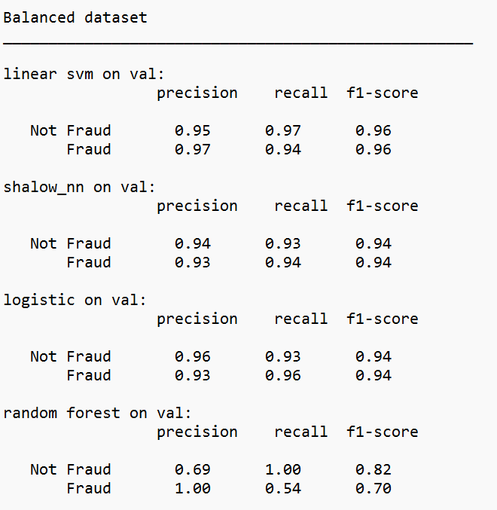
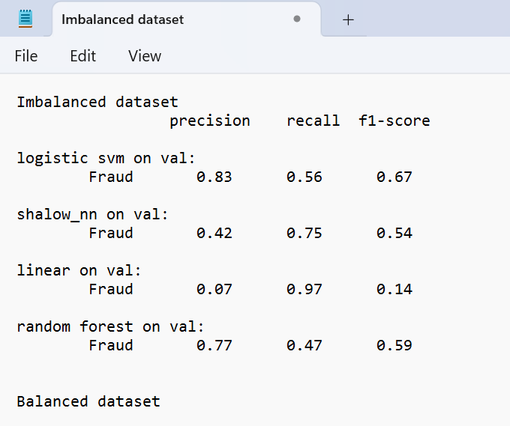
Summary + Results
Linear svm wins

Slide 14
Conclusion
Different models excel in different scenarios—it’s up to the company to decide which model aligns best with their business needs and what customers value the most.
Balancing the data significantly improved the performance of all models.
Next Steps: Deploy the Linear SVM model in a production-like environment to test its performance on new, unseen data. This will help evaluate its real-world applicability and effectiveness in detecting fraudulent transactions.

Slide 15
References
TensorFlow Documentation: Sequential Models: https://www.tensorflow.org/api_docs/python/tf/keras/Sequential
Dataset: https://www.kaggle.com/
Random Forest model: https://www.geeksforgeeks.org/ml-credit-card-fraud-detection/
https://nevonprojects.com/credit-card-fraud-detection-system-python/
Google colab: https://colab.research.google.com/drive/1sqc_jFQkJenvlmw1KPTzdVw1omMo0T8x?usp=sharing
Why tap to pay options?: https://youtu.be/S7dWigI7Soc?si=XALaaAH52wWDetg4
IEE research paper: https://www.computer.org/csdl/proceedings-article/assic/2024/10508010/1Wz3EiQjVKg
IEE Ensemble and deep learning: https://www.computer.org/csdl/proceedings-article/icpcsn/2024/863400a224/1Z069PrpQ1G
Google scholar: detection methods forn credit card fraud https://ieeexplore.ieee.org/abstract/document/5762457

Slide 16

Thank you!
Questions

